Slide 1
XV Protein
NDFS 5560
Fall 2015

Slide 2
Protein quality
Ability of protein to satisfy nutritional requirements
Important when intake is marginal
Most common limiting a.a.s
sulfur (methionine, cysteine)
lysine

Slide 3
Protein quality
Based on amino acid content
Essential a.a. in smallest [conc.] is ‘limiting’
Methods
PDCAAS-protein digestibility correct amino acid score
Protein efficiency ratio-growth of rat on limited protein content
Biological value- nitrogen retention

Slide 4
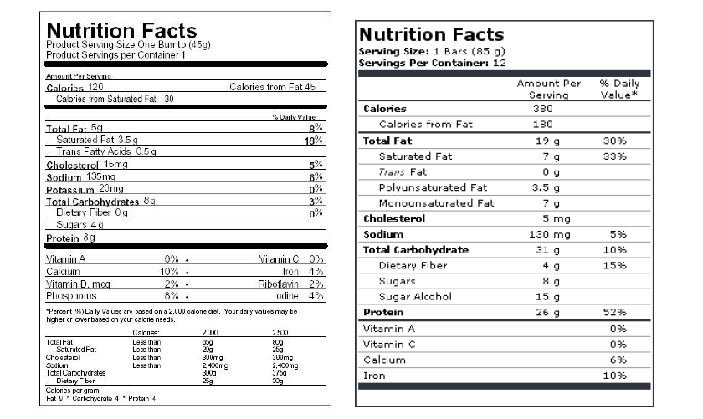
Protein quality & labels

Slide 5
Protein functionality
Non nutritive roles ingredients play in foods
Physical and chemical properties that affect behavior of molecules in foods
Examples-
Solubility, gelation, emulsification, foaming, water holding

Slide 6
Protein functionality
Complex food systems require a number of different ingredient functionalities

Slide 7
Protein ingredients
Concentrate=50-80%
Isolate>90%

Slide 8
Processing effects on functionality

Slide 9
Solution behavior due to pH & pI
Electrostatic forces between protein molecules are determined by the isoelectric point of a protein and the solution pH

Slide 10
pH Effects on Protein Solubility
Solubility of β-lactoglobin (measured as mg nitrogen/mL) is influenced by pH and NaCl concentration

Slide 11
Effects of salts on solubility
Protein solubility increases as [NaCl]↑
‘salting in’
Due to enhanced surface charges
At [NaCl] > 1M solubility ↓
‘salting out’
Due to competition for water
Practically unpalatable

Slide 12
Protein gels
3D network of x-linked proteins in aqueous system
i.e. yogurt, cheese, gelatin, processed meats
High water content (95-98%)
Thermoset-irreversible
Egg white
Thermoplastic
Gelatin

Slide 13
Gelatin Formation from Collagen

Slide 14
Heat is often needed to cause protein gelation

Slide 15
Water Binding Comparison of Soy, Caseinate, & Whey Protein Concentrates as affected by Temperature
Water binding of three protein concentrates as a function of temperature

Slide 16
Effects of pH on water binding by beef muscle homogenates.
Water binding of beef homogenates as a function of pH

Slide 17
Salt Increases Water Binding in Raw Meat
Water binding of raw turkey muscle breast and thigh homogenates as a function of NaCl concentration

Slide 18
Proteins as Emulsifiers
Formation of temporary and protein stabilized emulsions a) temporary emulsions are formed between oil and water when no emulsifier is added. The emulsion breaks quickly b) proteins can act as emulsifiers to stabilize emulsions by reducing the interfacial tension between oil and water

Slide 19
Emulsification Factors
Factors affecting formation and stability of protein-based emulsions

Slide 20
Measuring Emulsification Ability of Proteins
Emulsion stability
-Rate of creaming is high for droplets >5 micrometers in diameter
-For smaller particles accelerated tests used
i.e. centrifuge
Emulsion capacity
-How much lipid can a protein emulsify
-Measured by adding lipid to emulsion under shear
-Rapid loss of viscosity at failure

Slide 21
Protein Foam Formation
Behavior of proteins during foam formation and collapse

Slide 22
Measurement of Foaming Ability

Slide 23
Denaturation
Protein function depends on 3D shape
http://www.youtube.com/watch?v=_xF96sNWnK4
Changing shape results in activity loss
Denaturation-change in native structure
∆ 2°, 3°, 4° structure
May be reversible

Slide 24
Denaturation
Factors
Heat
Sheer
Hydrostatic pressure
Acid/base
Salt
Used to manipulate texture of foods
May decrease (milk) or increase (soy) solubility

Slide 25
Hydrolysis
Chemical (acid) or enzymatic
May affect ingredient functionality
Soy & fish proteins have increased water binding and emulsion capabilities
Limited enzymatic treatment of soy protein increases solubility at isoelectric point
May affect sensory properties
i.e. fish sauces

Slide 26
Heat processing
May improve protein quality by inactivating protease inhibitors
i.e. soybean trypsin inhibitor
Facilitates digestion by promoting unfolding of protein structure
Develops flavor via protein interactions

Slide 27
Amino Acid Stability

